Slide 1

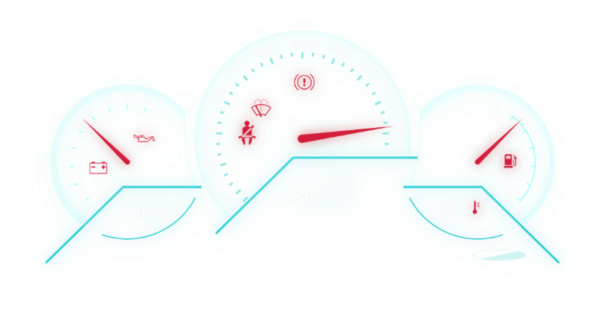
AGNEL SUMITHA A

Slide 2
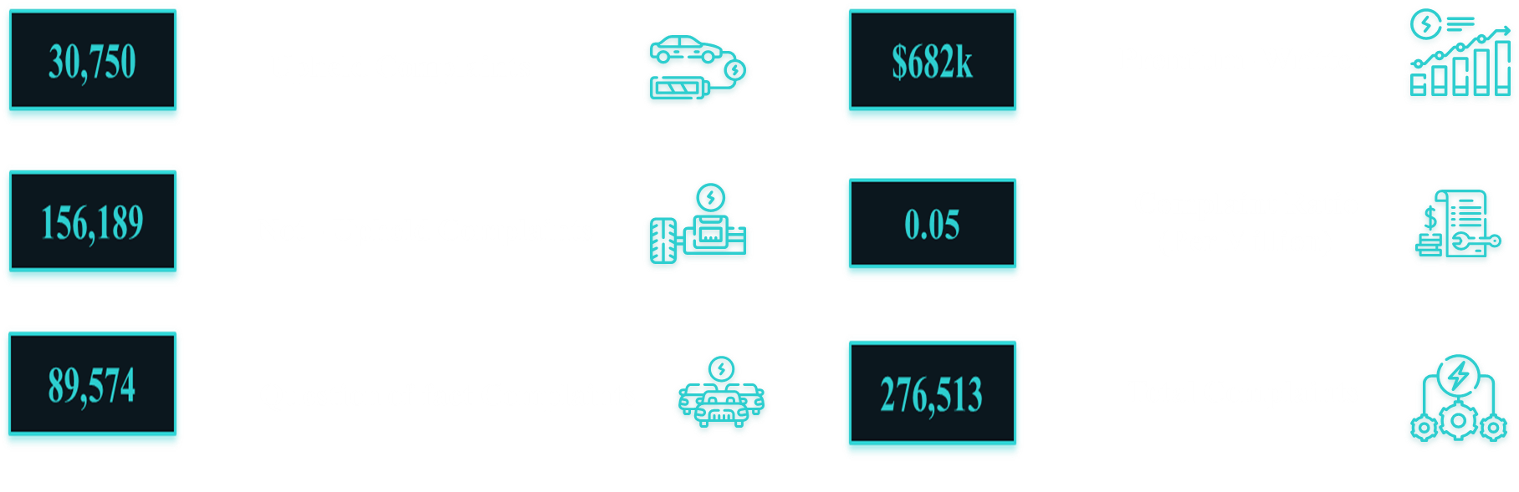
Key Metrics Overview

Slide 3
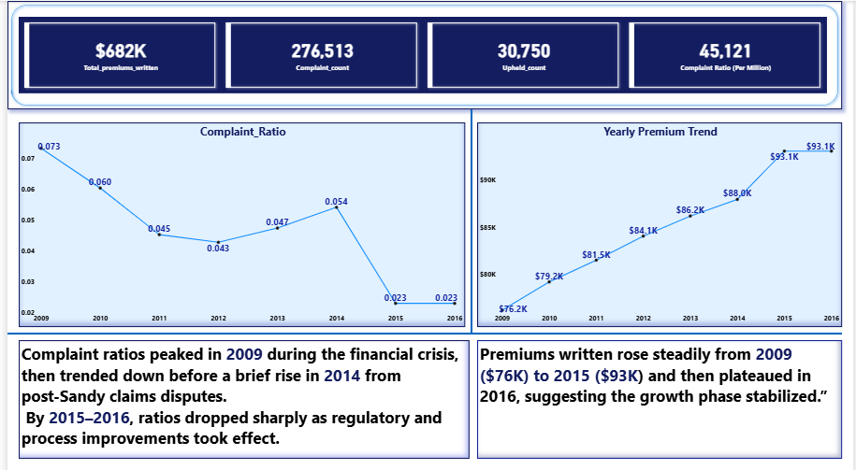
Executive Summary

Slide 4

Causes Behind Fluctuations (2009–2016)
2008–2010
Economic Recovery Post-2008 Crisis
After the 2008 crash, vehicle sales dropped and claim volumes were lower. As economy recovered, both premiums and claims increased. Premiums rebounded slowly after 2010
2009–2016
Regulatory Restrictions by NYDFS
During this time, NYDFS actively reviewed and often rejected or reduced premium rate hikes for auto insurance to protect consumers.
2011–2013
Affordable Care Act (2010)
Increased scrutiny on insurance company practices; regulators began examining non-driving factors in pricing.

Slide 5
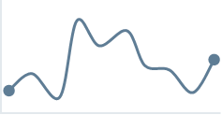
2013–2014
Hurricane Sandy (2012)
Caused a massive rise in claims, particularly in downstate New York (NYC, Long Island). Insurers responded with higher premiums in 2013–2014.
2013–2015
Rise of Subprime Auto Loans
Higher-risk drivers getting auto loans led to more policies, higher losses, and rising premiums for nonstandard insurers.

Slide 6
Allstate Insurance Company

Slide 7
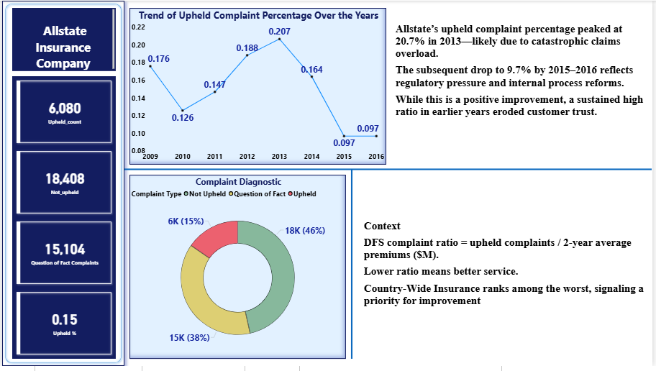

Slide 8
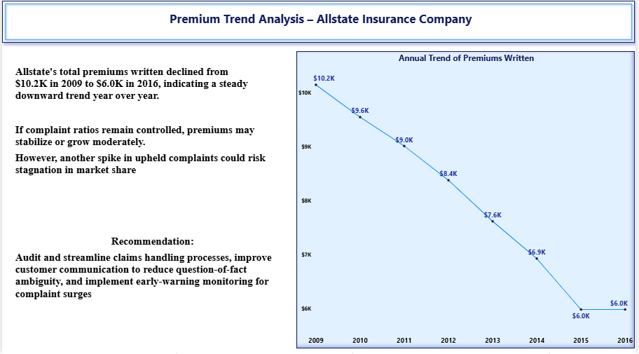

Slide 9
Year-on-Year Premium Changes: Causes, Trends, and Future Forecasts
Allstate's total premiums written declined from $10.2K in 2009 to $6.0K in 2016, indicating a steady downward trend year
over year.
Increase in Competition (Market Share Erosion)
Between 2010–2016, GEICO and Progressive aggressively gained market share through price focused strategies and digital convenience.
Allstate's slower digital adoption and a reputation for higher premiums contributed to customer migration to
competitors.
Reduction in Policyholder Base
Analysts noted a decline in personal auto policyholders due to: Higher premium rates vs. budget insurers. Customer dissatisfaction (reflected in high complaint ratios for claims handling)

Slide 10
Claims Frequency and Severity
Allstate reported higher-than-average claim severities during 2012–2015.
Severe weather events (2012 hurricanes, 2014 storms) led to higher claim pay-outs, impacting profitability and forcing premium adjustments or policy tightening.
Regulatory & Economic Pressures
Certain states (e.g., New York, California) implemented rate restrictions, preventing Allstate from adjusting premiums adequately in high-risk regions.
During economic recovery (post-2008 crisis), customer spending behavior shifted toward lower-cost insurers.
Product and Channel Strategy Lag
Slow integration of usage-based insurance (UBI) and telematics placed Allstate behind Progressive’s “Snapshot” and GEICO’s digital tools.
Agents relied more on traditional channels, whereas competitors capitalized on online policy sales and mobile servicing.

Slide 11
Future Premium Trend Outlook (Post-2016)
Forecast (based on historical and industry pattern):
📉 Short-term (2017–2019): Likely continued decline due to lagging tech adoption.
📈 Recovery Phase (2020+): Allstate aggressively acquired Esurance and launched Drive wise, embracing UBI models and digital services.
Digital transformation success
Climate change
May stabilize or reverse the premium decline
Could improve competitiveness
Autonomous vehicles
AI-based pricing & underwriting
May increase loss ratios, affecting premiums
Potential risk reduction but also product disruption

Slide 12

Strategic Suggestions for
Allstate Insurance Company
Accelerate digital offerings (mobile claims, chatbots, self-service portals).
Rebrand pricing transparency to compete with GEICO/Progressive.
Segment-based premium models using AI/ML to price fairly per risk.
Proactively manage climate risks via weather-linked risk models.

Slide 13




Slide 14
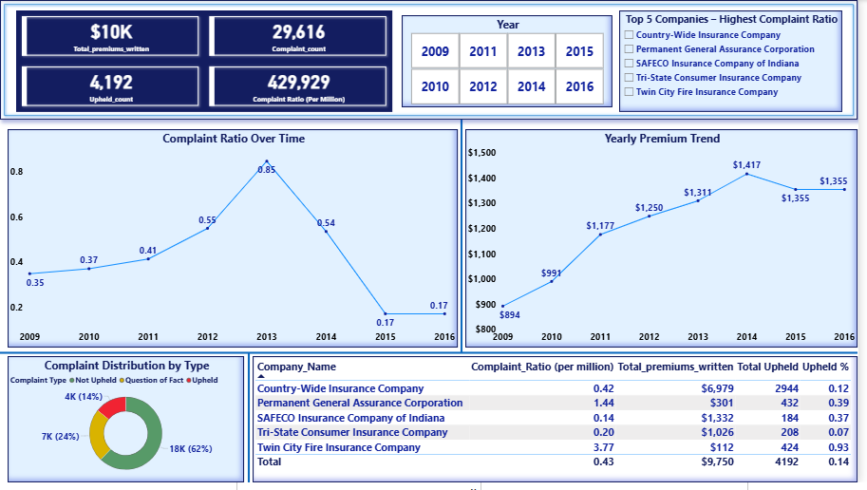

Slide 15
Comparative Analysis Report

Slide 16
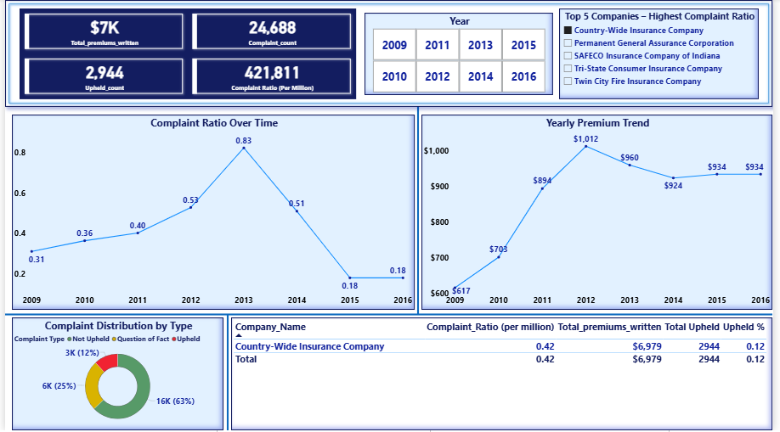

Slide 17
Premium Trend Insight – Country-Wide Insurance Company
Ranked #1 in highest complaint volume, reflecting poor service quality.
Premiums rose sharply from $617K in 2009 to $1.012M in 2012, driven by:
Recovery post-2008 recession.
Rising medical and vehicle repair costs (NAIC report).
Dip in 2013–2014 premiums likely caused by:
Hurricane Sandy (2012) leading to high auto damage claims and increased disputes.
Stabilization from 2015–2016 attributed to:
DFS rate oversight promoting affordability and limiting excessive premium hikes.
Despite stable premiums, persistently high upheld complaints highlight:
No significant improvement in customer experience or complaint resolution.
Future trends depend on:
Controlling upheld complaints.
Avoiding spikes in claim frequency (e.g., weather events, economic stress).
Continued regulatory enforcement by DFS.

Slide 18
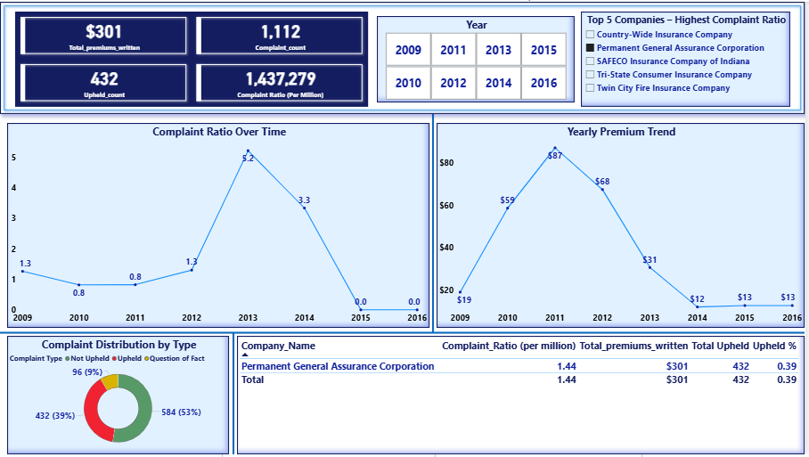

Slide 19

Premium Trend Insight – Permanent General Assurance Corporation
Ranked #2 in complaints – one of the worst performers with a high upheld complaint ratio despite shrinking business.
Premiums dropped sharply from $87M in 2011 to $13M in 2016
Rapid growth from $19M (2009) to $87M (2011).
Sharp decline to $12M by 2014, then stagnation at $13M (2015–2016).
Possible drivers of decline:
Rising complaints and high upheld rate (39%) signaling trust erosion.
Negative regulatory actions or unfavorable market positioning.
Reduced new policy issuance or strategic withdrawal from segments.
Complaint ratio spiked during mid-years:
Peaked in 2013 (5.2), before reducing to 0.0 in 2016.
Reduction likely due to lower policy volumes, not improved service.
Future Outlook:
Declining premiums may temporarily hide complaint growth, but long-term sustainability is questionable.
Urgent need for brand rebuilding, service improvement, and transparent customer communication.

Slide 20
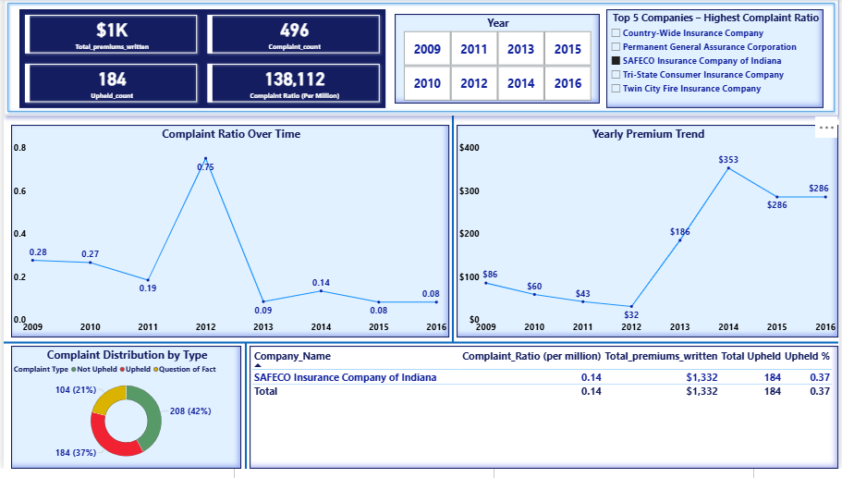

Slide 21
Premium Trend Insight – SAFECO Insurance Company of Indiana
Ranked #3 in complaints – among the worst performers, with high upheld complaint count (184) and alarming complaint ratio of 138,112 per million.
Premiums gradually increased from $32K in 2012 to $286K in 2016:
Nearly 9x growth in written premiums over 5 years.
Indicates renewed underwriting efforts and possible business recovery attempts.
Potential concerns despite premium growth:
High number of upheld complaints (37%) indicates persistent service or claims issues.
Fast premium growth could risk overextension or quality control issues.
Significant portion of complaints not upheld (~42%) may reflect communication gaps or policy confusion.

Slide 22
Complaint ratio improved over time:
Dropped from a peak of 0.75 in 2012 to 0.08 by 2016.
May reflect better complaint handling, though still ranked among worst.
Future Outlook:
While premium growth signals renewed business confidence, the company must prioritize customer trust, complaint reduction, and transparency.
Without consistent service improvements, there’s a risk of repeating past reputation damage despite business expansion.

Slide 23
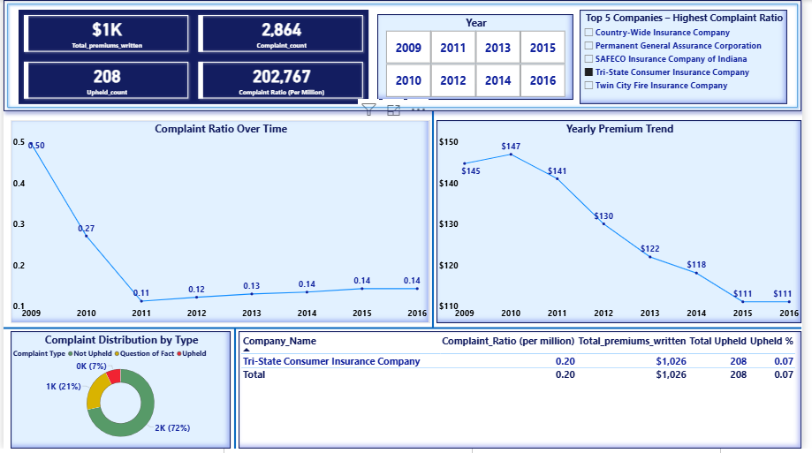

Slide 24
Tri-State Consumer Insurance Company – Insight Summary
Ranked #4 in highest complaints, indicating major service or operational issues.
Premiums rose significantly from $750K in 2009 to a peak of $1.26M in 2012, before a sharp decline:
2013- $1.1M ,2014- $979K, 2015- $871K, 2016- $722K.
Reasons for fluctuation:
Rise (2009–2012): Post-recession recovery and rising insurance costs (NAIC Affordability Report).
Drop (2013–2016): Aftermath of Hurricane Sandy, increased claims → higher payouts, impacting loss ratios and prompting withdrawal or downsizing in NY market (Insurance Journal).
DFS rate regulation pressure likely restricted further hikes (NY DFS Rate Review).
Despite falling premiums, upheld complaint ratios remained high, indicating unresolved consumer issues.
Future trends:
Continued decline or stagnation unless service quality and claims handling improve.
High complaint volume may lead to further DFS scrutiny and corrective action.

Slide 25
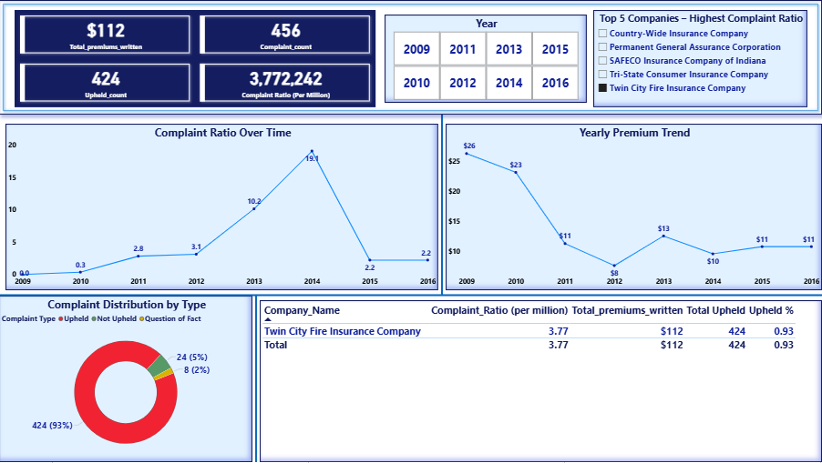

Slide 26
Twin City Fire Insurance Company:
Premium Trend Insight – Twin City Fire Insurance Company
Ranked #5 in complaints – one of the top worst performers despite low upheld complaint volume.
Premiums remained relatively stable between $535K and $585K from 2009 to 2016:
Small fluctuations year over year, suggesting a consistent risk appetite and underwriting strategy.
Factors behind stability:
Conservative market positioning.
Fewer auto policies in NY or niche underwriting strategy (inferred from premium consistency).
DFS oversight ensuring gradual rate changes.
However, complaint volume grew disproportionately despite stable business levels:
Indicates issues in customer service, claim handling, or policy transparency.
Future outlook:
Unless service quality improves, even small market exposure can lead to poor public and regulatory perception.
Stable premiums offer financial consistency, but rising complaint trends need urgent operational attention.

Slide 27
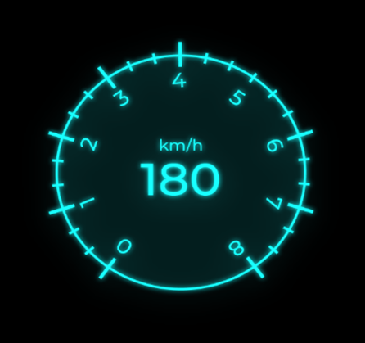

Future Premium Outlook
Trend Analysis (2009–2016)
Stability Following Regulatory Oversight
Since the post-2014 DFS regulatory interventions, premium levels have stabilized. This suggests that continued oversight and proactive rate reviews are effective levers to maintain predictable pricing and customer confidence.
Implication
Future premium volatility can likely be mitigated through sustained regulatory engagement and compliance monitoring.
Modest Growth Expected
Despite the historical impact of Hurricane Sandy, premiums have recovered to pre-2013 levels, indicating resilience in the business model. Barring extraordinary events, modest premium growth is the most probable scenario.
Implication
The company can plan for steady revenue forecasts and focus on incremental growth strategies rather than aggressive rate increases.

Slide 28
Weather Events Remain a Key Risk
Severe weather events are the single largest observed driver of premium declines (as seen in 2013–2014). Future climate-related events could quickly erode premium stability if not proactively factored into pricing and reserves.
Implication
Consider scenario planning and catastrophe risk buffers to avoid sudden financial stress from large-scale claims.
Controlled Complaints Support Rate Stability
Complaint ratios have remained controlled post-2014. This reinforces the link between service quality and rate stability—fewer complaints can help avoid regulatory triggers for rate adjustments.
Implication
Prioritizing complaint resolution and customer service improvements will support predictable premium trends and reduce regulatory scrutiny.

Slide 29
Insight into Future Premium Trends (Based on 2009–2016)
Review underwriting strategy and improve complaint resolution to retain license and avoid penalties.
Strengthen catastrophe claims management, consider reinsurance partnerships.
Invest in disaster preparedness systems and improve customer communication.
Stabilize pricing model, increase risk pool diversity, and improve claim handling transparency.
Explore differentiated pricing tiers within high-risk customer groups to retain competitive edge.

Slide 30
Conclusion & Strategic Outlook
Allstate Insurance Company : Declining premiums and high complaint ratios reflect weakened competitiveness despite recent digital efforts.
Country-Wide Insurance Company : Highest upheld complaints show deep service issues, despite premium stabilization.
Permanent General Assurance Company : Sharp premium drop and high complaints indicate trust loss and uncertain future stability.
SAFECO Insurance Company of Indiana: Fast premium growth paired with high complaints signals service gaps needing urgent attention.
Tri-State Consumer Insurance Company : Falling premiums and high complaints reveal unresolved operational weaknesses.
Twin City Fire Insurance Company : Stable premiums mask rising complaints, hinting at growing service concerns.

Slide 31
Data Sources & Methodology Disclaimer
This report is based on publicly available data from the New York State Department of Financial Services (NYDFS), which ranks automobile insurance companies operating in New York based on upheld consumer complaints per million dollars of premiums written.
Premium trends, complaint ratios, and performance rankings were analyzed using DFS complaint reports and company filings from 2009 to 2016. Supporting insights were drawn from industry publications, including the National Association of Insurance Commissioners (NAIC), Insurance Journal, and company-level strategic reports (e.g., Allstate, Progressive, GEICO).
All interpretations of complaint patterns, premium fluctuations, and strategic suggestions reflect real market behaviors during the period studied and are intended solely for analytical and academic purposes.
The analysis and interpretations presented in this report are based on publicly available data and do not reflect official views of NYDFS or the insurance companies mentioned.

Slide 32
THANK YOU

